Slide 1
Recommending a strategy
Ideas for today and tomorrow

Slide 2
Agenda

Slide 3

About us

Slide 4
Product overview

Slide 5
Product benefits

Slide 6
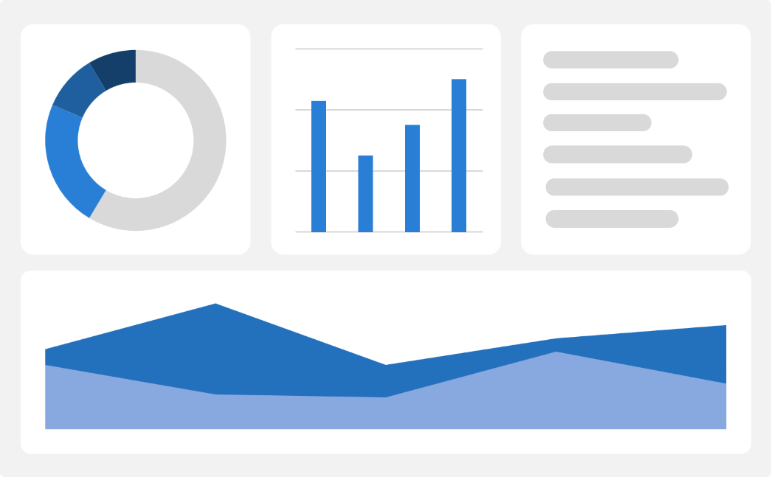
Market comparison

Slide 7

Market overview

Slide 8
Growth strategy
Expand
Foster collaborative growth
Enhance
Ensure a tailored and user-focused experience
Explore
Capitalize on emerging global markets

Slide 9
Traction
Milestone | Quarter
Product launch | Q1
10,000 user milestone | Q2
Strategic partnership | Q3
Campaign launch | Q4

Slide 10
Areas of growth
Quarter | Revenue ($) | Expenses($) | Net Profit($)
Q1 | $200,000 | $150,000 | $50,000
Q2 | $300,000 | $200,000 | $100,000
Q3 | $400,000 | $250,000 | $150,000
Q4 | $300,000 | $200,000 | $100,000

Slide 11
Competitive landscape

Slide 12
Summary

Slide 13
Thank you

